Slide 1
Project report of Tetris
Ming Ming

Slide 2
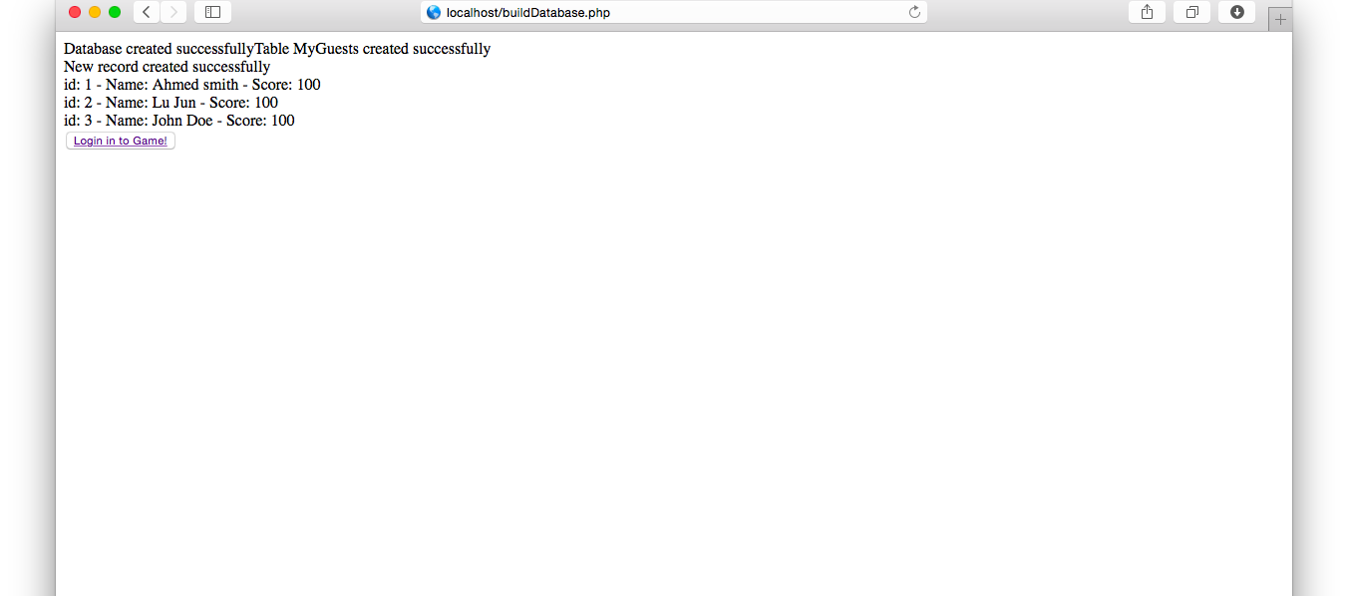
Create database using “buildDatabase.php”
Enter localhost/buildDatabase.php in the address bar and this php file will build an database named “TetrisDb” in mySQL and create a table named “myGuests”. Click Login in button to login in. You may need to change the root password in the line 15.

Slide 3
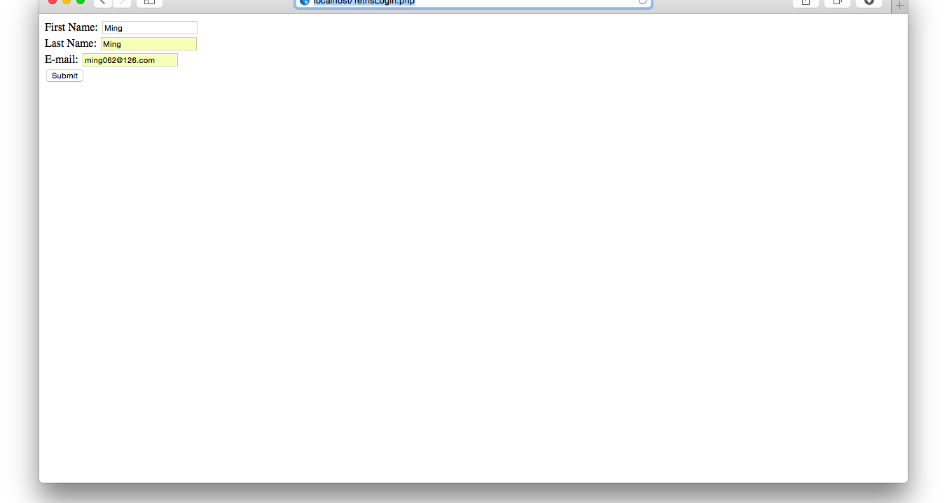
Enter your information
Then you will be connected to “TetrisLogin.php”, enter your information here. Click submit to enter game.

Slide 4
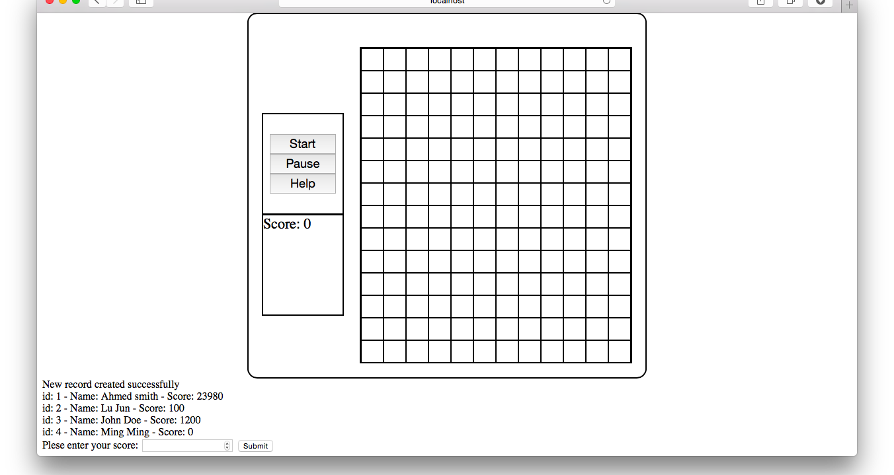
Insert user information into database
Together with other user information, new user information displayed in the left conner of the window, score is 0 at the first. (If the database files does not work, you can execute tetris.php directly and the game will still work)

Slide 5
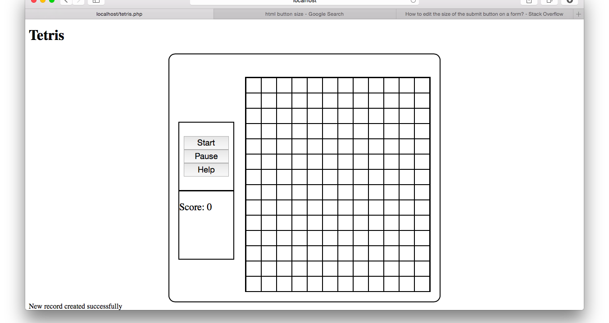
Build the game map by function
Use “appendchild” method to add 168 “div” (12x18) elements in the “play console ” div frame.

Slide 6
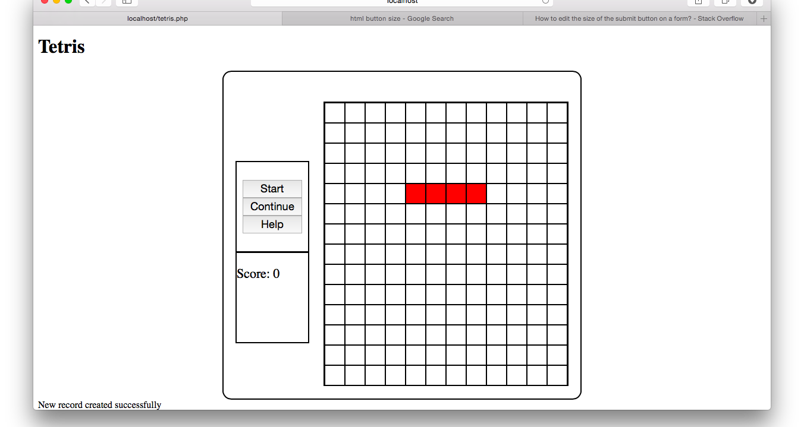
Pause and continue
Press “start”, the block start to drop, press ”pause” to pause; “pause” button change to “continue”. To continue, press “continue”.

Slide 7
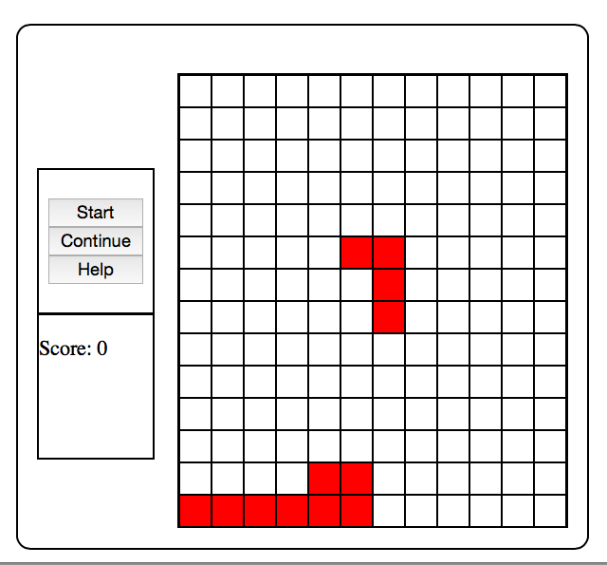
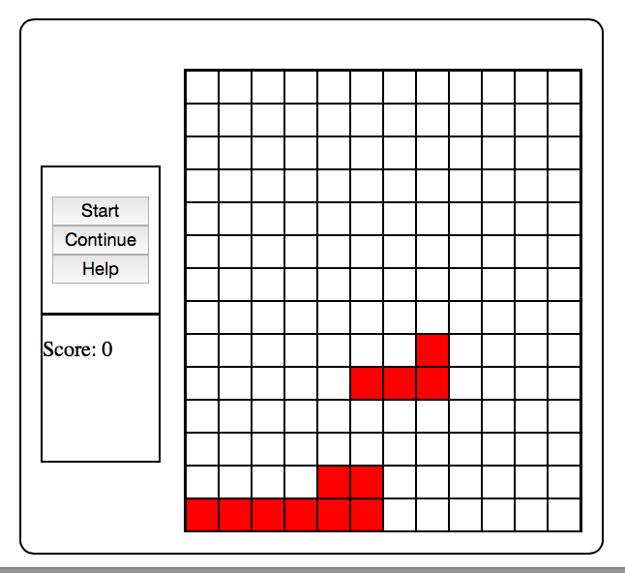
Rotation
Use up arrow key rotate the block

Slide 8
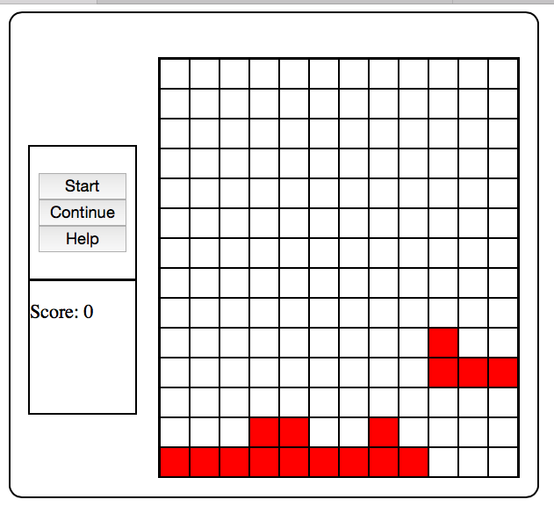
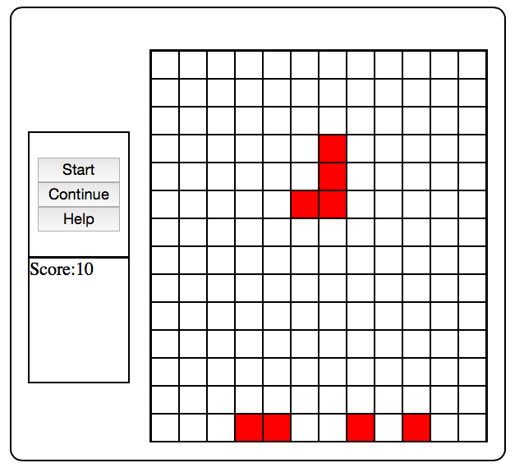
Delete line when filled
When 1 line is filled with block, delete this line and add 10 to score.

Slide 9
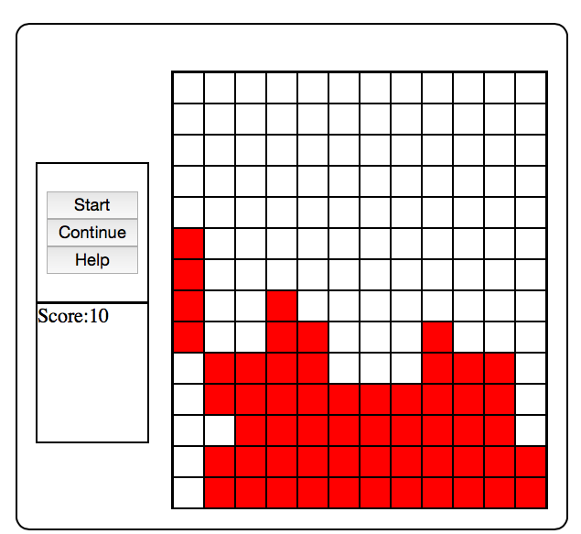
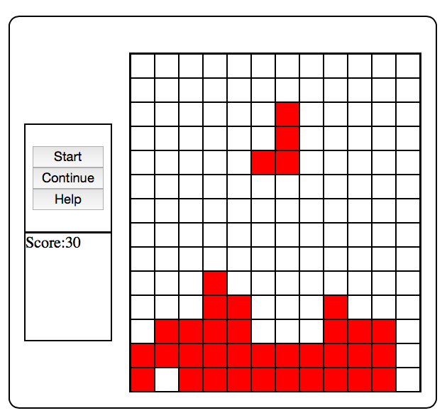
Also works for multiple lines deletion

Slide 10
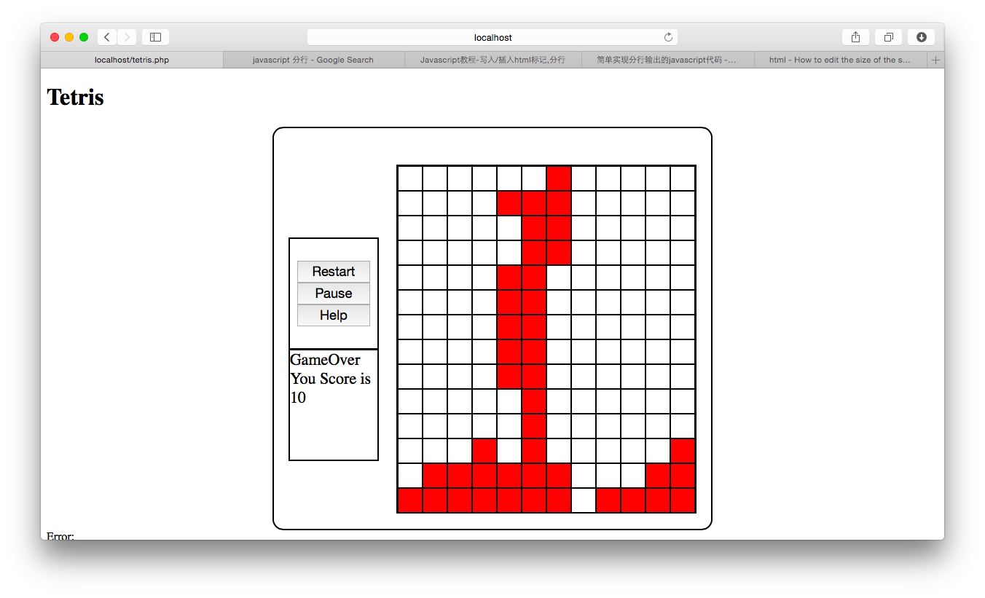
Collapse
When the last block touches the ceiling, game is over. Score panel says ”game over” and display the final score. “Start” button turn to “Restart”. Click “restart” to restart.

Slide 11
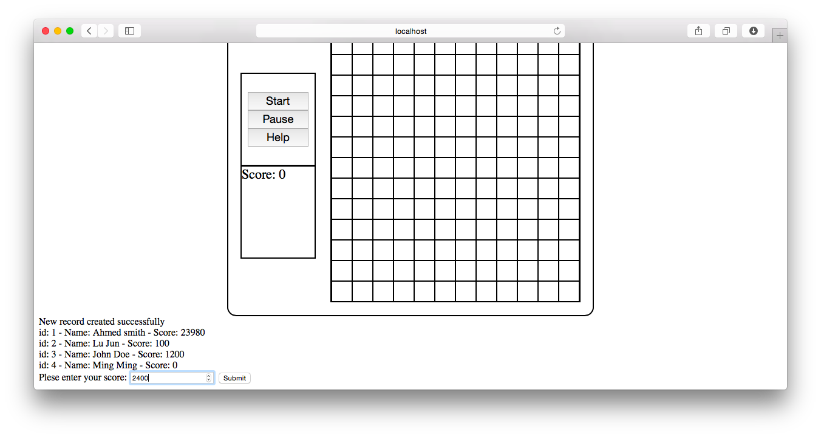
Enter score and submit
After game over, enter the score in the input box and click submit

Slide 12
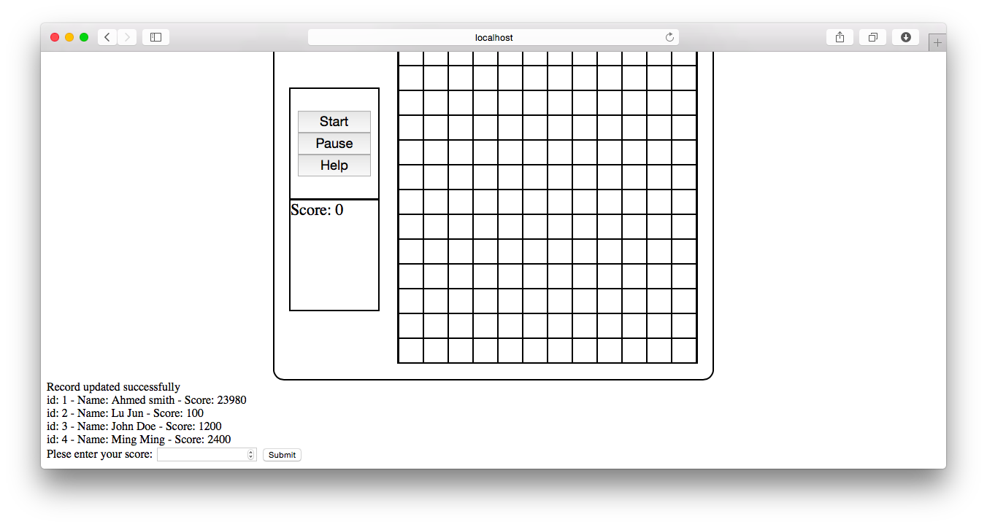
Score updated
Score is updtated

Slide 13
How to impliment
Use function to build the main game frame. “appendchild” method to add 168 “div” (12x18) elements in the “play console ” div frame. Change the background of each block element to show the block and use function control to implement moving, rotating and line deleting.
All the control function and array are put in to one object “Tetris”. Use an object “Tetris.Ctrl” to store control information. Use an object “Tetris.Ctrl.blockRec” to record if each block element is occupied (1) or not (0). All block shape information are stored in “Tetris.FK”.

Slide 14
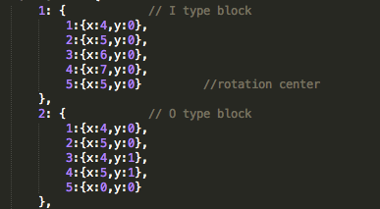
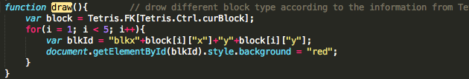
How to implement
Block shape information is stored in an associative array
This 5th element is rotation center for every block.
Use this function to irritate and draw the blocks

Slide 15
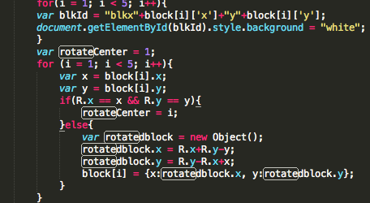
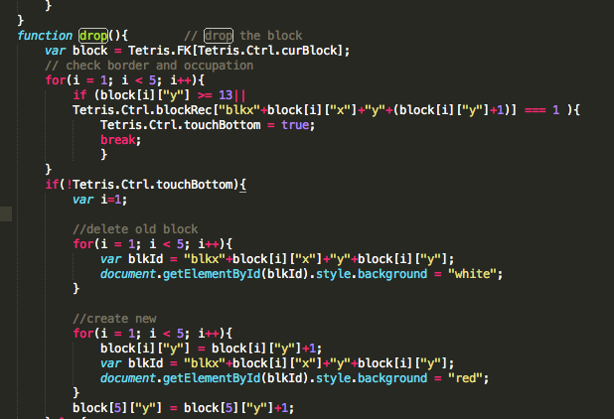
How to implement
For “rotate”, check the border and occupation first, then use the fifth value of “Tetris.FK” item as rotating center and rotate using the following algorithm:
New X = Center X + (Center Y – old Y);
New Y = Center Y - (Center X – old X);
For “drop” function, check if the dropped block crosses the border or collides to an occupied block first. If not, clear the old block and draw a new one with Y axis plus 1. “left” and “right” use the similar principle.

Slide 16
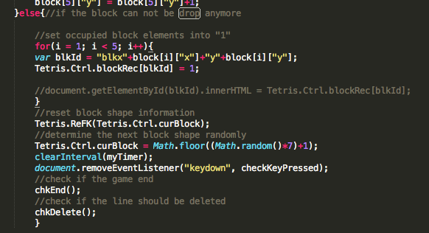
How to implement
When touch the bottom
When the block can not be dropped anymore, set “Tetris.Ctrl.touchBottom” to be true, reset “Tetris.FK” object (store shape information).

Slide 17
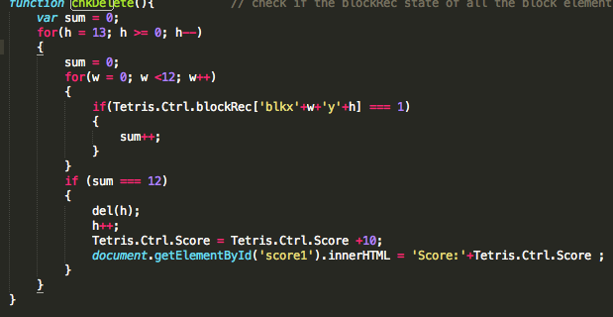
How to impliment
Check if delete a line. When the sum of block elements status value is up to 12 (all of them are occupied), delete this line.c

Slide 18
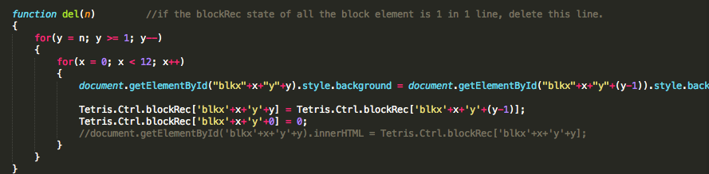
How to implement
Delete Function. Line n is the line we want to delet. Copy the background color and occupation status of Line n from line n-1. Irritate and repeat this process for all the lines higher than line n.

Slide 19
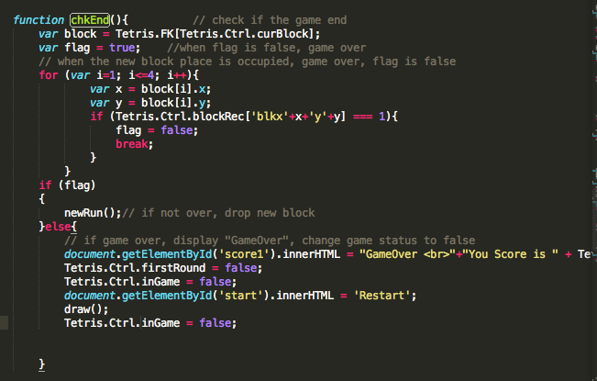
How to implement
Check ending function
Start “newRun” to get another block to drop from the top if not end.
Display play “Game Over” if end.

Slide 20
Problems and solution
“Cross border” problem when deletion multiple lines.
To realize deleting multiple lines, in the “chkdelete()” (check which line to delete) function I incremented the irritation viable, which make the function check that line again after del() function.

Slide 21
Problems and solution
But problem still occurred when deleting multiple lines. Only 1 line could be deleted at 1 time. I checked several points and find out the problem exist in the del() function. I was using ‘for(y = n; y >= 0; y--)’ but when y =0, y-1 in this function became minus which make this function cross border and could not work normally.

Slide 22


Problems and solution
Another problem occurred when the game is over and the score is not zero, the score panel could not display “Game over”. But it worked well when the score is zero. Then I find I used 2 id in the score penal, like this:
When I updated the scores, I used :
document.getElementById('score1').innerHTML = XXX
In this way the content of score1 div is changed to new score number, and the <p> element inside did not exist anymore.
Then when game is over I use the following code to change score panel content:
document.getElementById('score2').innerHTML = XXX
The instruction could not find ‘score2’ and all the code after it did not execute.
Solution is: I deleted the <p> element in the score penal and use ‘score1’ directly to show game over.

Slide 23
Problems and solution
Make block status visible.
I use the array of “Tetris.Ctrl.blockRec” to record all the occupation status of every block element. When the block touched the bottom and could not be moved, I change these spots to 1. When I realized deletion and checked occupation, I found there were some problems and it would help if I can see these occupation status directly. So I use “innerHTML” method to show these 1 or 0 status when build the map and every time when the status changed.

Slide 24
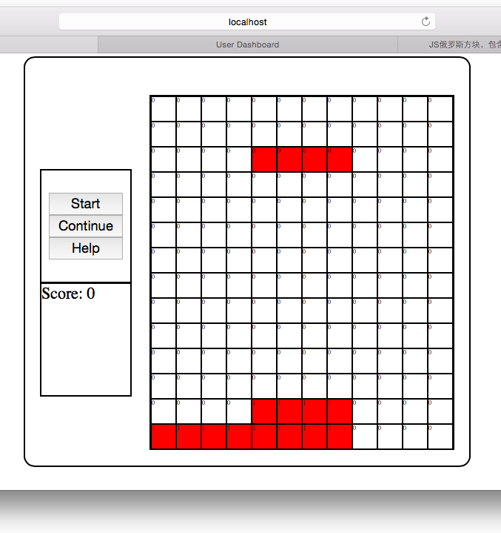
Problems and solution
Like this:
In this way I can see the status directly , make debugging much easier. After finishing I comment out these ‘status displaying’ code, make status invisible again.

